Slide 1
A Competitive Review of Huawei Storage and Key Values to Our Customers Boston Storage Solution Group June 2020

Slide 2
Market Share and Growth

Slide 3
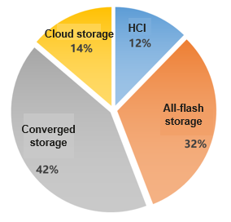
Enterprise Storage Sales in 2019
1
Countries/regions with large-scale sales
Russia: >100M USD
10 international markets: >10M USD
Russia, Brazil, UAE, Germany, Hong Kong (China), France, Japan, South Africa, Switzerland, Spain
Indicator | YOY Growth
Global Order | 52%
China | 62%
Outside China | 31%
Global Revenue | 51%
China | 61%
Outside China | 30%
2
Breakthroughs in key industries and NAs Continuous breakthroughs and large-scale sales in finance, government, and manufacturing.
3
Rapid growth of all-flash storage 2019 revenue of all-flash storage outside China increased by 104%, representing 33% of the total storage revenue (2018: 20%). The core product OceanStor Dorado V6 was initially sold in batches.
Notes:
First, let’s review Huawei Enterprise Storage Sales in 2019.
The table at left shows the year to year growth in both the order and revenue in and out of China. We can tell from right that the largest sales out of China in 2019 were from the European market. Five of the top ten countries/regions with sales over $10M are from Europe, follows by 3 countries & regions from Asia. It is also impressive to note Russia generates > 100M sales revenue in 2019. Top three traditional customer industries, finance, government and manufacturing, continue to contribute large orders in 2019.
When comes to the storage product, all-flash storage enjoyed a good year in 2019. Its sales jumped up more than 100% in 2019 and took one third of the total storage sales, thanks to Dorade V6’s debut on market.

Slide 4

Key Countries/Regions Outside China: Revenue Grows by 30%
— 10 Large-Scale Sales Countries/Regions: >10M USD Each and 10 Growth Countries/Regions: >6M USD Each
Regions/Countries
27 countries/regions
Eurasia and Southeast Asia have surpassed 100% of the revenue objective.
The order and revenue fulfillment rate is <50% in the Southern Pacific and has decreased in Northeast Europe and Northern Africa.
Countries/regions making over 10M USD in product orders grew from 10 in 2018 to 13 in 2019. Countries/regions generating over 10M USD in revenue grew from 7 in 2018 to 10 in 2019
Russia: The first country outside of China with a sales revenue of over 100M USD
Germany and Turkey: Key countries with declines in POs and revenue
Country/ Region | PO YOY Growth | Revenue YOY Growth
China (CNY 100 million) | 67% | 68%
Eurasia | 74% | 83%
Southeast Asia | 100% | 102%
Southern Africa | 86% | 13%
The Middle East | 61% | 39%
Western European | -7% | 17%
Japan | 5% | 5%
Canada | -20% | 30%
CEE and Nordic Europe | -9% | -5%
Latin America Region | 69% | 24%
South Pacific | 3% | 23%
Northern Africa | -15% | -40%
Total | 52% | 52%
Outside China | 32% | 30%
Country/Region | YOY Order | YOY Revenue
Russia | 83% | 87%
UAE | 109% | 99%
Germany | -12% | -9%
Brazil | 51% | 25%
HongKong | 124% | 171%
France | 54% | 33%
Japan | 0% | 2%
South Africa | 72% | 80%
Switzerland | 37% | 56%
Spain | 68% | 73%
Nordic | 2% | 8%
Turkey | -9% | -11%
Italy | 70% | 65%
Thailand | 102% | 143%
Mexico | 276% | 31%
Kenya | 2620% | 1237%
Singaporee | -8% | 26%
Saudi Arabia | 190% | 88%
Netherlands | -37% | -42%
India | 10% | 30%
Indonesia | 128% | 77%
Korea | 28% | 17%
Pakistan | 60% | 15%
Algeria | -82% | -72%
Philippines | 39% | -22%
Nigeria | -139% | -11%
Egypt | 132% | 38%
Total | 49% | 43%
"Base" countries/regions
Revenue: > 10M USD
Revenue
Notes:
Here is the detailed sales number by countries and regions.
At left table, out of China, Eurasia and Southeast Asia are two regions seeing fastest sales growth, achieved more than 100% over the revenue goal in 2019. They are followed by many other regions with decent revenue growth. In the meantime, we also observe sales dips in northeast Europe and northern Africa.
At right table, we can tell the top 10 countries/regions generate > $10M revenue in 2019. This number increases from 8 of 2018. Again, Russia is the first country aside from China to achieve sales revenue over $100M in one year.

Slide 5
Centralized Storage Market Space and Target Industries: Finance, Government, and Manufacturing
Finance
Core banking
Application platform
Front-end channel
Office support
Opportunity 1: Mainframe offload for cost reduction and speed boost
Opportunity 2: Fast channel service growth and data exchange platforms demand high-performance storage.
SAM: US$3.9 B
Government
Social Security
Customs Service
Taxation Admin
Office automation
Opportunity: Policy-driven new storage requirement
SAM: US$3.2 B
Manufacturing
Serviceable and Addressable Market (SAM) in 2022: US$18.9 B
Finance, government, and manufacturing account for > 50%
ERP
EDA
CRM
PDM
Opportunity 1: Enterprise core ERP + BI
Opportunity 2: PDM and autonomous driving AI training require high-performance storage
SAM: US$2.6 B
Notes:
After looking back of 2019 sales number, now let’s look forward.
Here is the forward looking for the Huawei Centralized Storage --- Dorado V6 alike product. The total serviceable and addressable market for Huawei storage in 2022 will be almost $19B. It is for the world market not including north America. The market segment in line of business (LOB) is still dominated by finance, government, and large manufacturing enterprises, with > 50% of the market share in total. We believe there will be strong growth and major opportunity in all three major lines of business.
In Finance, we expect to see strong opportunity from replacing old mainframe systems for cost & performance, along with expansion of financial services such as new channels and emplacement of high-speed data exchange platforms, both of which will raise strong demand for high performance storage.
We expect governments of different countries/regions continue to invest in infrastructure with more innovative technologies. The recent covid-19 pandemic only shows how crucial & urgent it is that each government has a streamlined and renovated infrastructure for responding to such a large scale urgent need.
We also expect to see at large manufacturing enterprises the continuous increasing investment on enterprise resource planning (ERP), Electronic Design Automation (EDA), Customer Relationship Management (CRM) and Product Data Management (PDM) with prevailing of AI and business intelligence that create more value for them. All such investments encourage higher demand for high-performance centralized storage.

Slide 6
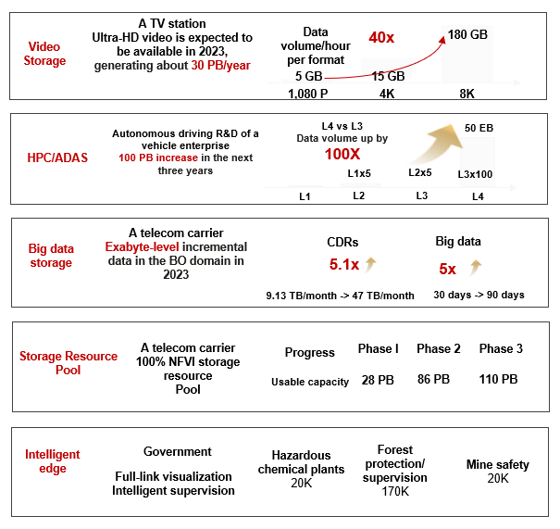
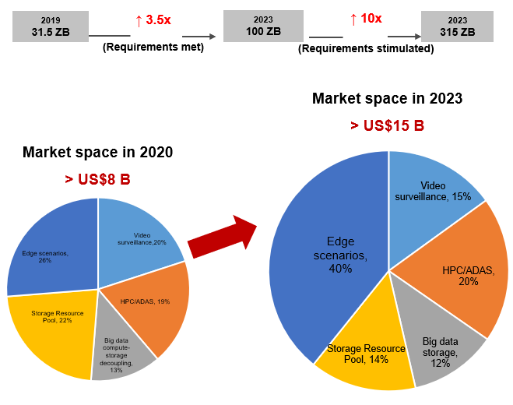



Distributed Storage Market Space and Trend: New Technologies Such as 5G and AI Speed-up Data Production
Continuously meet strong customer requirements and expanding market on distributed storage
A TV station
Ultra-HD video is expected to be available in 2023,
generating about 30 PB/year
Data volume/hour
per format
40x
180 GB
Video
Storage
5 GB
15 GB
2019
31.5 ZB
↑ 3.5x
(Requirements met)
2023
100 ZB
↑ 10x
(Requirements stimulated)
2023
315 ZB
1,080 P
4K
8K
Autonomous driving R&D of a vehicle enterprise
100 PB increase in the next three years
L4 vs L3
Data volume up by 100X
50 EB
HPC/ADAS
Market space in 2023
> US$15 B
L1x5
L2x5
L3x100
L2
L3
L1
L4
A telecom carrier
Exabyte-level incremental data in the BO domain in 2023
CDRs
Big data
Market space in 2020
> US$8 B
Big data
storage
5.1x
5x
9.13 TB/month -> 47 TB/month
30 days -> 90 days
Storage Resource
Pool
A telecom carrier
100% NFVI storage resource
Pool
Progress
Phase I
Phase 2
Phase 3
Usable capacity
28 PB
86 PB
110 PB
Intelligent
edge
Government
Hazardous chemical plants
20K
Forest protection/ supervision
170K
Full-link visualization
Intelligent supervision
Mine safety
20K
Notes:
In the meantime, popular 5G, AI and IOT create another strong demand for massive data storage, a native market for Huawei distributed storage.
Here on this page are a few sampled mass storage demands from customers in various line of business.
The first is a TV station that expects to see a strong demand of saving its massive video clips in HD and ultra-HD format. One can see that, when resolution is bumped up from 1080P to 8K, the data size for the clip of same time length increases ~40 times.
Next, Auto Driving Assistant Service (ADAS) also produces data explosion. Auto drive level 1 to level 3, from preliminary driving assistance to partial auto-drive, see data size increase by 5 times from previous level. However, it is expected to see 100x data increase when growing into “full autonomous driving” at level 4. Btw, tesla claims its auto-drive feature is level 2, giving everyone a sense of the idea.
Telecom carriers generate huge amount data every day. They come from its call detailed record (CDR) and other business operational related big data. It also coming from the storage resource pool for the services it provides for the end-user. Both are expected to see huge storage demand in near future.
Edge, particularly intelligent edge will play a major role in various application scenarios and will be a high demand area. From the pie chart at right. We expect to see the total SAM for massive storage to be almost double in next 3 years, with all segments bumping up in total dollar number but expect to see a big jump in edge scenario.

Slide 7

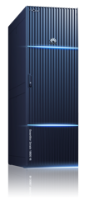


Focusing on Existing Frontiers and Expanding to Edge & Cloud Data Services
Two existing frontiers
Core production transaction
(Transactional structured data)
Mass data analytics
(Mass unstructured data storage & analysis)
Opportunities
Edge data
Opportunities
Mass unstructured data growth brings in huge market opportunities for distributed storage.
Huawei distributed storage breaks data silo with interworking protocols (NAS, Object, HDFS) on the same data. It naturally empowers data lake with tiered high capacity and separate computing/storage that allows full data utilization for better analyzing performance.
Data lake invigorates cold data, turn it into warm one.
The core production and transactional system of enterprises is a valuable market.
The data accessing rate jumps up much faster than data size increase, create strong demand for high performance storage.
NVME, new media (SSD & SCM), all flash, high-end storage integrated databases (centralized deployed) are there to meet industry requirements for performance improvement.
Intelligent edge
Opportunities
5G, IOT and AI make Enterprise edges to store and process data. Simplicity and intelligence are core competitiveness.
Precise
marketing
Self-service
analytics
Operational
decision-making
Real-time
credit reporting
FusionCube provides full-stack integrated O&M and delivery
ERP
CRM
Billing
Tran-saction
Real-time risk
control
Core production and transaction
Mass data
FusionCube
Center
Block
File
Object
HDFS
AI image
Unified intelligent management
Cloud-based AI training
Converged databases and storage
Protocol interworking
AI platform for
major industries
Huawei public
/private cloud
OceanStor centralized storage
(All-flash and converged storage)
OceanStor distributed storage
(OceanStor 100D/9000)
Kunpeng | Ascend
Kunpeng | Ascend | x86
Notes:
At this page, we will see how Huawei storage can focus on existing frontiers while expanding to edge and cloud data services.
There are two “existing” frontiers.
The first frontier is the core transactional service of structured data for key business in finance, government and large enterprises. It concentrates on the high performance and high reliability and it is always the most valuable market. Even the total data size may not be increased as fast, the frequency of data access has been jumping up exponentially. This brings up a huge demand for centralized high-end storage such as Huawei Dorado v6. In addition, the end-to-end NVMe, the new media innovation in SSD and storage class memory (SCM), all flash array, new high-end storage integrated database and many innovative technologies make Huawei Dorado v6 high-end storage product a good fit for this market.
The second frontier is from the fast growth of the massive unstructured data. This market has two major challenges here --- how to store the massive data and store them for long, and how to access the massive data for various data analytical purposes. Huawei distributed storages, Oceanstor 100D alike, is the best fit for this market. First, its large scale-out architecture makes it a best fit for storing fast growing massive data. Second, its tiered architecture makes it very economical for large and long-term data storage with decent performance, bridging the gap between online, nearline and off-line data services. Next, its separation of computing and storage allows best data utilization and high IO bandwidth that is ideal for data analysis. Last and the most important, the 100D will be supporting full-fledged inter-working protocols through NAS, Object and HDFS on same data set, making data analysis much easier and cost-effective. All such features make 100D alike a native option for a customer-built data-lake that helps to store massive data and create value from cold data.
Edge data could be treated as a separate scenario of massive unstructured data. AI, 5G and IOT makes enterprise-edge intelligent with data processing and storage capability, and it is a fast-growing area. Unified intelligent management for life cycle management, along with convenient interfaces with clouds for data sharing and AI training, and various AI services for major industries are the key value here. FusionCube is the ideal fit for this area.
This ends my presentation on this topic.

Slide 8
OceanStor 100D Distributed Storage

Slide 9
Why Distributed Storage: New Trends Influence the Enterprise Storages
① AI, 5G, IOT, Multi-Clouds Go Mainstream
④ Distributed & Scale out Architect on New Fabric
Customers embrace big AI data analytics to differentiate their products/services.
AI simplifies data operations, automate complex tasks and create opportunity
AI, 5G, IOT & multi-Clouds generate more data and move data freely, create more storage demand.
Scalable architecture easily meet dynamic workload.
NVMe-oF and RoCE ensure high performance through fabric
Auto-load balancing on distributed infra enables fault tolerance.
Split front-end and back-end helps to ensure performance and multi-path.
⑤ Storage and Computing Gain Independence
② End-to-End NVMe Gathers Momentum
Fast storage fabric can move data close to service for data intensive app.
More affordable & durable media makes the separation possible
Smart SSD controller will offload more load
Smart storage enclosure offloading erasure coding and data recovery.
Future near data processing (NDP) on SSD controller is in vision.
NVMe brings high performance to storage
NVME supports 64K queue length and lock-free access.
Both NVMe-oF and NVMe over ROCE provide the best storage fabric performance.
NVMe is replacing SCSI and becoming new enter point.
⑥ Integrated Data Protection
③ All Flash Array Picks up Fast
Data is protected from failures, both internal and external.
These could be any system failures, disasters, even human errors.
Disjointed and overlapping technologies can’t meet the requirements.
Integrated approaches to securing one of every business’s most valuable assets.
NVMe fully reveals SSD high performance potential.
Flash price keep dropping while capacity is increasing, fast
New SSD can server full spectrum storage functionality
Notes:
Before I start Oceanstor 100D in details, I would like to quickly go over the latest new trends that influence the enterprise storages and why distributed storage can be a good opportunity today.
First, on demand side, AI as leading service goes mainstream. Service providers who embrace the game-changing power of big data & AI analytics will continue to differentiate their products and services and deliver measurable business enhancement for customers. AI, with help of 5G, IOT and multi-cloud, is poised to produce considerable opportunities in saving time and money, and to create values & opportunity for business. The dilemma here is on one hand, AI need to access massive customer data including both hot, warm and cold data to create value, on the other hand, AI, 5G and IOT services themselves also produce massive data. This raises up two challenging demands: the demand to store massive data and store them for long, and the efficient way to extract right information from massive data for AI analytics.
Luckily, such fast data growth can be answered by scale-out distributed architecture. The latest storage-optimized NVMe-oF or ROCE networks are built to deliver reliable high-throughput and ultra-low latency data transfer and makes scale-out possible. Automatic load balancing over distributed infrastructure also provide a native fault tolerance. Separating front and backend interconnection both ensure performance and multi-path redundancy.
The separation of storage and computing is of a new architectural approach that has emerged to tackle the challenges presented by data-intensive workloads. Separating storage & computing hardware has been made possible by new storage fabric and networking. As storage media continues to be more and more affordable and durable, the distributed model to easily share data across multiple compute nodes for data accessing is becoming attractive. This type of architecture provides good tiered cost-effective storage capacity as well as the ideal data utilization performance.
Last but not the least, data reliability is ensured through integrated protection at all storage layers. The failure may come from both internal and extern, so disjointed technologies won’t meet the need. Only integrated data protection, from every component, to every module, to the whole system and solution level can provide 6-nine or even 7-nine level protection.

Slide 10
Core Requirements for Distributed Storage Systems
Distributed Storage Hot Requirement Statistics
Scalability
60.7%
60.1%
58.2%
56.6%
51.5%
50.8%
47.3%
36.4%
Performance
Usability
Users'
core requirements
High scalability
Reliability
I/O performance
Usability
Cost
Hotspot performance
Data security
Features
Source: 130 questionnaires and 50 bidding documents from carriers, governments, finance sectors, and large enterprises
Reliability
Primary Expectation from customer:
High scalability --- how easy to expand cluster
High reliability --- data integrity and reliable system
Outstanding I/O performance --- be even and smooth
Good usability --- easy to manage.
Cost-effective capacity and perf. --- can’t be expensive
Cost
Notes:
With the merits of distributed storage we just enumerated, let’s take a look at the customer expectation on distributed storage. The survey at this page tells us that the core value of distributed storage for customer sare on following five areas: Scalability, Reliability, Performance, Usability and Cost. They are the also core value for Huawei Oceanstor 100D, that we will get into them in more details.

Slide 11
Best Value of OceanStor 100D: Compared with Others (1)
Vendor | Vendor-C | Vendor-V | Vendor-N | Vendor-E | OceanStor 100D
E2E NVME ready | Not support NVMe | Not support E2E-NVME | Support E2E NVMe | NO. It only supports SATA/SAS and NVRAM (battery backed) | NVMe Ready: can support end-to-end NVMe for high performance with NVMe drives. AI Fabric: ultra low latency --- 30us for BE network
Perf | Not support RDMA, Performance for small I/Os and EC is poor. | Multiple disks form a disk group (DG). One DG is configured with one SSD cache. Perf is poor for heavy write when SSD cache is full (cache write-back) | IO stack is not fine-tuned for perf Not known for good IO perf number | Share memory (High locking overhead) Good perf at large read/write Poor for small IO | Good small IO perf both AF & Hybrid--- High-Ratio EC Aggregates and ROW Balances. Intelligent Scheduling (CPU, cache, IO schedule) & Auto-Load-Balancing for hotspot elimination. Smart QoS & consistent performance. Perf consistency within 5% variation. Plog interface --- Append only making best SSD/HD write performance. IOPS per se: 200% x Vendor-C, 160% x Vendor-V.
Relia-ble Device & HW | SDS only. has Limited control at device failure | SDS only. Has limited coverage for device failure | SDS only. Has limited coverage for device failure | Has device monitoring No device failure prediction | Reliable component --- SSD controller 3M Hr MTBF Sophisticated device monitoring. Sophisticated device failure prediction

Slide 12
Best Value of OceanStor 100D: Compared with Others (2)
Vendor | Vendor-C | Vendor-V | Vendor-N | Vendor-E | OceanStor 100D
Relia-ble Sys | CRUSH algorithm constraints: insufficient subhealth processing | EC Data reconstruction has great impact on performance. Cache SSD failure may take down the host | All nodes participate in rebuild (as load is balanced) | Write data to multiple NVRAM to avoid SPF. Support both EC and mirroring Rebuild is efficient Tolerate up-to 4 node failure in a cluster | New EC schedule allows quick rebuilt --- half time of other distributed storage EC rebuild work load is smoothly distributed. Auto/even load balancing remove hotspot Tolerate simultaneous 4-node failure in a cluster. More in consequential way. Not gained at the sacrifice of performance and life.
Reliable DC & Solution | Replication only | Active-Active Stretched cluster. | Replication Only | Async Replication Only | Active-Active Cross Cluster redundancy: quick recovery. 99.9999% overall reliability.
End-to-end Verify | Only static checksum | Only static checksum & scrubbing | Only static checksum & scrubbing | Support dynamic DIF check. | End to end DIF verification for both data and LUN address, besides static checksum and regular scrubbing
Scal-ability | No limit. Restricted by the CRUSH algorithm limit. Adding nodes at large-capacity expansion is cumbersome. | Only support up to 64 nodes Adding new nodes won’t auto trigger load balancing when capacity <80% full. | No limit, but generally up to 32 nodes for replication limitation. | Can scale up to 252 nodes. Adding new node is light-weight in share mem model. | One cluster can scale up to 4096 storage nodes. Cluster does fast node balancing when add a node, avoid large data moving but make new resource immediately effective. Disks, computing nodes, and storage nodes could be added separately or together. Adding node will not impact primary IO traffic. Plog byte addressable --- native for future SCM

Slide 13
Best Value of OceanStor 100D: Compared with Others (2)
Vendor | Vendor-C | Vendor-V | Vendor-N | Vendor-E | OceanStor 100D
Relia-ble Sys | CRUSH algorithm constraints: insufficient subhealth processing | EC Data reconstruction has great impact on performance. Cache SSD failure may take down the host | All nodes participate in rebuild (as load is balanced) | Write data to multiple NVRAM to avoid SPF. Support both EC and mirroring Rebuild is efficient Tolerate up-to 4 node failure in a cluster | New EC schedule allows quick rebuilt --- half time of other distributed storage EC rebuild work load is smoothly distributed. Auto/even load balancing remove hotspot Tolerate simultaneous 4-node failures in a cluster. Not gained at the sacrifice of performance and life.
Reliable DC & Solution | Replication only | Active-Active Stretched cluster. | Replication Only | Async Replication Only | Active-Active Cross Cluster redundancy: quick recovery. 99.9999% reliability at cluster level.
End-to-end Verify | Only static checksum | Only static checksum & scrubbing | Only static checksum & scrubbing | Support dynamic DIF check. | End to end DIF verification for both data and LUN address, besides static checksum and regular scrubbing
Scal-ability | No limit. Restricted by the CRUSH algorithm limit. Adding nodes at large-capacity expansion is cumbersome. | Only support up to 64 nodes Adding new nodes won’t auto trigger load balancing when capacity <80% full. | No limit, but generally up to 32 nodes for replication limitation. | Can scale up to 252 nodes. Adding new node is light-weight in share mem model. | One cluster can scale up to 4096 storage nodes. Cluster does fast node balancing when add a node, avoid large data moving but make new resource immediately effective. Disks, computing nodes, and storage nodes could be added separately or together. Adding node will not impact primary IO traffic. Plog byte addressable --- native for future SCM

Slide 14
Best Value of OceanStor 100D: Compared with Others (3)
Vendor | Vendor-C | Vendor-V | Vendor-N | Vendor-E | Oceanstor 100D
Usability | Lack of cluster management poor usability at maintenance interfaces Support three protocals but not on shared data. | Has vCenter for large system management. Adding node is decently easy. No one-key upgrade for both SW and FW (except on VxRail on Dell servers) | Usability is decent Adding node is decently easy. Support one key upgrade for SW/FW | Easy to scale. Support Support one key upgrade for SW/FW | Three-Layer Intelligent O&M Work well with other ecological management system --- including VMWare vCenter. Ultra-Large Cluster Management and Scaling When add new nodes, the system incurs fast node balancing, avoiding migration of large data and impact to production performance. One-key non-disruptive upgrade (SW, FW).
Cost | Community product with low cost: Very low EC ratio (33%) for three-way mirroring No dedup and compression supported | High cost: All SSDs support intra-DG deduplication and non-global deduplication, EC supports only 3+1 or 4+2, low Efficiency (75% or 66%) New drive added in Dedup/compression DG won’t take effect, unless the DG is deleted and recreated. | Support Dedup & compression Strip size is no more than (4,1) EC ratio is only 80% | Software non-RAID EC, can set with high Ratio Proprietary HW known to be expensive. Inline dedup & compression only. Yielding ratio isn’t high | High EC ratio (22+2, ratio 91.67%) Global deep dedup and compression create more virtual capacity. Effective erasure coding scheme reduce data redundancy Efficient data tiering for best performance/cost ratio for end-user.

Slide 15
Best Value of OceanStor 100D: Inter-working Protocals
Native Protocols | Block | File | OBJECT | HDFS | Multi-Protocols Share in one Cluster | Multi-Protocols Share in the same Pool | Inter-working Protocols on Same Data
Vendor-C | YES | YES | YES | YES | YES | YES | NO, each protocol works on its own data.
Vendor-V | YES | NO | NO | NO | N/A | N/A | N/A
Vendor-N | YES | YES | YES | NO | YES | ??? | NO, each protocol works on its own data.
Vendor-E | NO | YES | YES | YES | YES | YES or NO. Need a separate ECS pool for object meta-data. | OBJ is through ECS built upon file, the performance is not good. Oceanstor 100D object perf is 300% better than that of Vendor-E
OceanStor 100D | YES Perf is: 200% of Vendor-C 160% of Vendor-V | YES | YES | YES | YES | YES | YES. File/OBJ/HDFS can work on the same set of data. Allow sharing of dedicated hardware. Allow easy management.

Slide 16
OceanStor Dorado

Slide 17
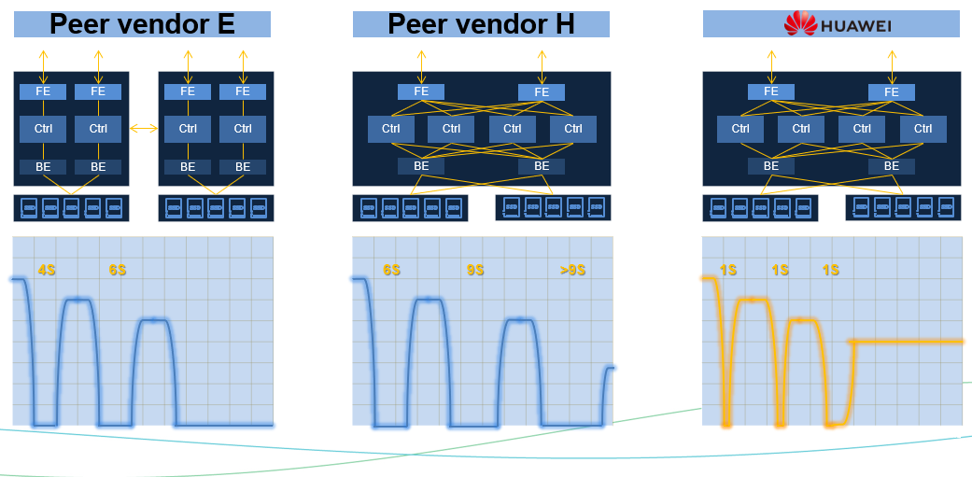
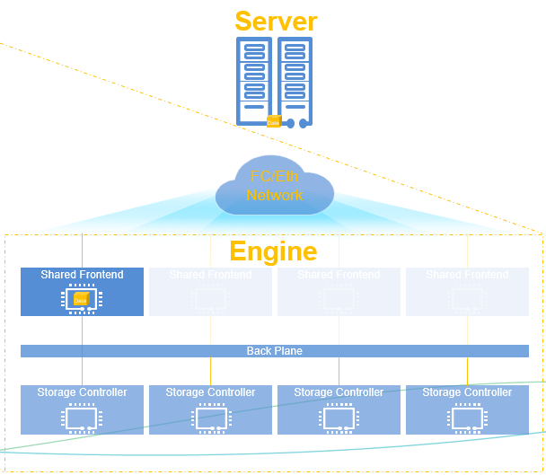
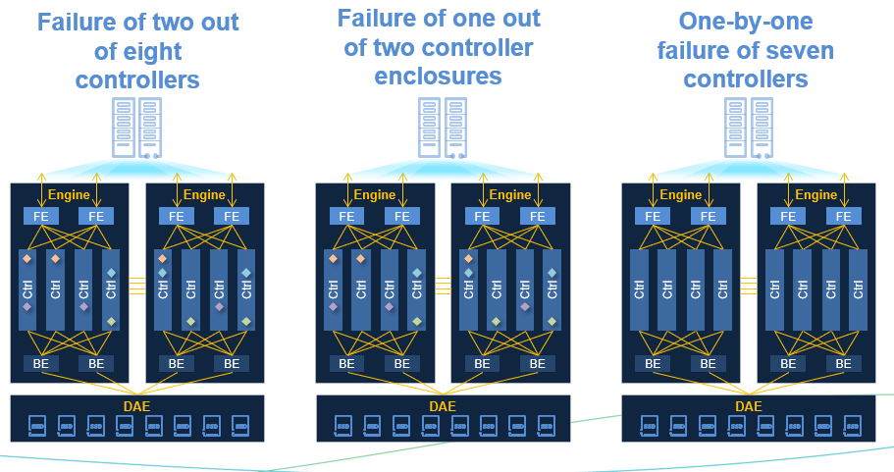
Dorado Competitive Edge – Front End
1 second controller failover
Shared front-end adaptor
Best controller failure tolerance (7/8)
Front End
Inside
Back End
Outside
Management
Notes:
Key message: Front end is the key to both performance and business continuity, we have 3 highlights in our FrontEnd listed in the bottom right corner. Make sure you remember them by heart when talking to customer, and comparing with other vendor’s products.
Dorado’s 1 second controller failover time is industry leading, this ensures best business continuity
As you can see from numbers in top left corner comparison chart, Dorado has a big advantage in controller failover compared to other 2 biggest vendors
How was this achieved? Dorado has a unique shared FE adaptor design (fully meshed front end), all front end FC modules are connected to the same backbone and available to all controllers. When one controller fails, the host can keep the same old connection with the FE module, and load will internally (virtually) rewired to the new controller to serve I/O.
Benefit: host (client) will not see FC session breakage during controller failover, there is no need for session rebuild.
Dorado also has the best failure tolerance in industry, it can tolerate 7 out of 8 controller failure sequentially, we have more details in next slide (Back end)

Slide 18
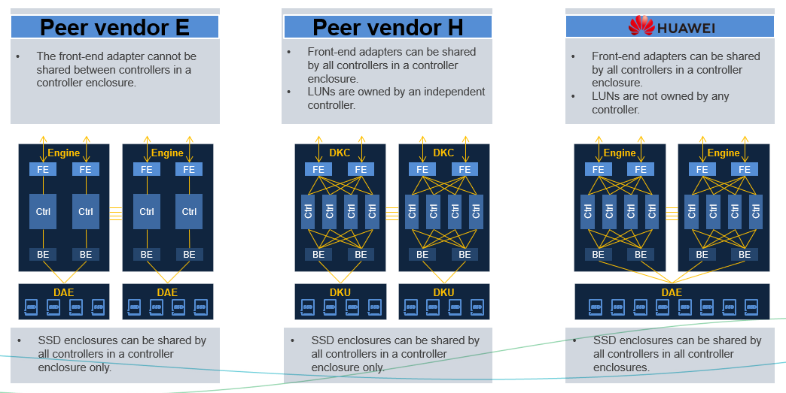
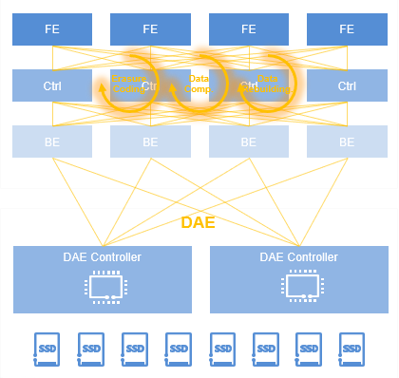
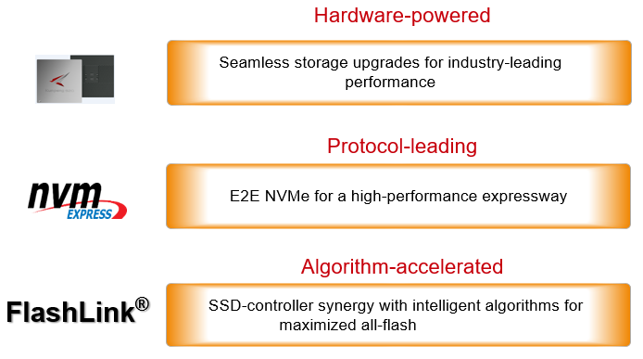
Dorado Competitive Edge – Back End
Fully connected back ensures best reliability and enables end-to-end load balancing
Intelligent DAE offload EC/compression/dedup
End-to-end NVME with unique FlashLink acceleration
Front End
Inside
Back End
Outside
Management
Notes:
Key message: Back end is how we achieve the magics presented to customers (hosts), we also have 3 highlights here.
Dorado’s full mesh connected backend, analyze gaps between Dorado and peer, this is why we can do 7 fail out of 8
Smart DAE is a unique feature of Dorado, or at least the amount of offloading we do, highlight EC/dedup/compression are all offloaded, so controller CPU can be dedicated to I/O processing and other business logic
Highlight E2E NVME enables much shorter I/O pathway, make it possible to achieve 20M IOPS and 100us I/O latency. Mention SPC-1 benchmark
Ask audience to throw some thoughts on relationship between throughput and latency

Slide 19
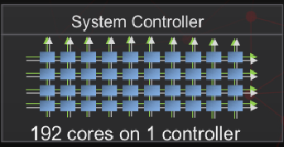

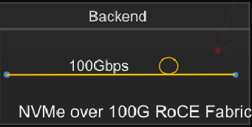
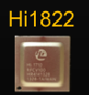
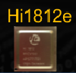
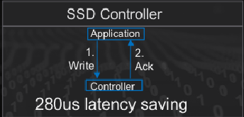
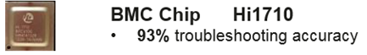
Dorado Unique Competitive Edge - Flashlink™ Hardware
High Performance CPU
High speed 100Gps.
Low latency
RDMA/FC/Eth/InfiniB/TCP
0.5ms consistent latency
3M hr MTBF, highest in industry
Local wear leveling
Bad block mgmt.
Data Redundancy
Background inspection
Full SAS/NVMe support
16TFLOPs computing pwr
Good for inline AI help for caching & dedup
Sensor Monitoring
Error diagnostics
Front End
Inside
Back End
Outside
Management
Notes:
Highlight that competitors do not have specialty hardware, they typically only use commercial chips and lack deep software integration
All our competitors are relying on generic commodity chipsets for potential offloading capability, which is very limited, because chip vendor like Intel is not going to design a CPU or add a co-processor specifically for storage system, pretty much all they can do is very generic task like compression.
Compare to Huawei’s self-developed chipsets all the way throughout the stack with instruction set level integration, the difference is like 1 to 0 or 1 to 0.01.
Go through the chips from top down:
1. Kunpeng 920 is ARM based, but added additional capabilities, see whitepaper for details
2. Hi1822 is Huawei self-developed 100Gbps network chip with RDMA support, and compatible with lower speed like 25Gbps and 10G. With extremey low latency
3. Hi1812e is a very strong SSD controller with industry leading performance and durability
4. Ascend310 AI chip is integrated with storage software stack to help with real-time AI/ML analysis of access pattern to improve cache hit ratio and improve performance.
5. Hi1710 BMC chip provide rich system management and diagnostic features and is integrated with Huawei management software.

Slide 20


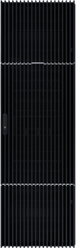
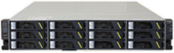
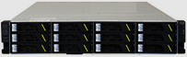
Dorado Competitive Edge - Comprehensive HA/DR Solution
With solution-level reliability measures, Dorado V6 can reach 99.99999%.
Site A
Site B
Synchronous
HyperMetro
Asynchronous
WAN
Oracle RAC
VMware Vsphere
Fusionsphere
Cluster
...
A
B
Asynchronous
A
WAN
B
Asynchronous
WAN
WAN
C
C
FC/IP
Network
WAN
FC/IP
Network
Serial
Synchronous
HyperMetro
Asynchronous
Synchronous Mirroring
WAN
WAN
A
B
A
B
Asynchronous
Asynchronous
WAN
WAN
C
C
IP
Network
IP
Network
Parallel
Production storage
Production storage
Synchronous
HyperMetro
Synchronous
HyperMetro
Site C
A
B
Asynchronous
Standby
A
B
Asynchronous
Asynchronous
WAN
Asynchronous
Standby
WAN
WAN
WAN
Quorum server
C
C
Ring
Front End
Inside
Back End
Outside
Management
Notes:
Key message here: Dorado HyperMetro implements industry leading HA/DR solution, and can handle more failure scenarios than competitors.
Dorado not only perform extremely well by itself as a single system, it also support rich HA/DR features, left side picture shows a typical HyperMetro reference architecture. On the top there is your application layer, could be a database, a hypervisor, or FusionSphere or anything else that use storage. Then you have two production Dorado systems synchronously mirrored, with a 3rd site Quorum server to ensure data integrity.
Right side picture shows Dorado 3DC layout with multiple flexible ways of HA/DR, synchronous or asynchronous, allows it to handle more failure scenarios than competitors. With solution-level reliability measures, Dorado V6 can reach 99.99999% reliability (7 9s, 3 seconds down time per year)

Slide 21


Robust Storage HA Cluster
Service continuity
Scenario #1
Scenario #2
Scenario #3
Peer vendor E
#1 | #1
#2 | #2
#3 | #3
#4 | #4
#5 | #5
#6 | #6
#7 | #7
#8 | #8
#9 | #9
Scenario #4
Scenario #5
Scenario #6
Scenario #7
Scenario #8
Scenario #9
Storage
Quorum server
Front End
Inside
Back End
Outside
Management
Notes:
This slides is just helping previous one

Slide 22
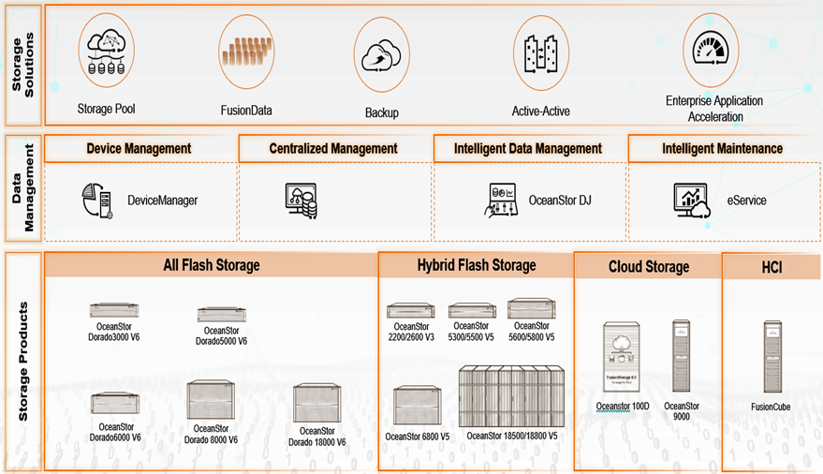
Dorado Competitive Edge – Full Range of Management Software
DeviceManager: Embedded/unified storage system management software to provide full storage system operation capacities, and many ease-of-use features
OceanStor DJ (DME): Powerful storage provisioning, abstraction, orchestration and automation engine, including multi-vendor support
eService: Cloud- and AIOps-based one-stop IT operation platform. Next-generation intelligent O&M platform designed around Huawei’s storage system management for self-driving autonomous systems
Front End
Inside
Back End
Outside
Management
Notes:
Highlight that 70% cost in modern corporate IT is operation cost rather than equipment, Huawei has full range of admin software to help make it much easier, and lead to less TCO
Full range of choices fits different scale: node -> cluster -> data center -> cloud, fully graphical with CLI and REST support at many layers
Intelligent: smart chips, systems, and cloud
Feature-rich: planning, deployment, configuration, provisioning, monitoring, optimization analysis, operation control, host auto discovery, centralized management in eSight, O&M, automation engine.
Ease-of: many user-friendly wizards for complex tasks
Unified: one-stop shop to manage all Huawei systems, and can extend to third-party systems via eSight and DJ
Open: RESTFUL, Industry standards (SMI-S), CLI, third-party integration

Slide 23







Dorado Competitive Edge – Comparison with Other Vendors
Comments: Not "NVMe Ready" Exclude appliance-based solution, e.g. VPlex & SVC Exclude Dorado 3000 Exclude Dorado mid-range model Not responsible for online data migration Exclude partial mid-range models Only support backend NVMe
 | OceanStor Dorado | ✔ | ✔³ |  |  | ✔ | ✔ | ✔ | ✔ | ✔ | ✔ | ✔⁴ | ✔⁴ | ✔ | ✔
 | PowerMax | ✔ | ✔ |  |  | ✔ | ✖ | ✔ | ✔ | ✔ | ✔ | ✖ | ✖ | ✖ | ✖
 | VMAX AF | ✔ | ✖ |  |  | ✔ | ✖ | ✔ | ✔ | ✔ | ✔ | ✖ | ✖ | ✖ | ✖
 | Unity | ✖ | ✖ |  | ✔ |  | ✖ | ✖ | ✖ | ✖ | ✖ | ✖ | ✖ | ✖ | ✖
 | AFF | ✔ | ✔ |  | ✔ |  | ✔ | ✖ | ✖ | ✔ | ✖ | ✖ | ✖ | ✔⁵ | ✖
 | Primera | ✔ | ✖ |  |  | ✔ | ✖ | ✔ | ✖ | ✔ | ✖ | ✖ | ✖ | ✔ | ✖
 | 3Par | ✔ | ✖ |  |  | ✔ | ✖ | ✔ | ✖ | ✔ | ✖ | ✖ | ✖ | ✔ | ✖
 | VSP 5000 | ✔ | ✔⁷ |  |  | ✔ | ✖ | ✖ | ✔ | ✔ | ✔ | ✖ | ✖ | ✖ | ✖
 | VSP G1500/F1500 | ✔ | ✖ |  |  | ✔ | ✖ | ✖ | ✔ | ✔ | ✔ | ✖ | ✖ | ✖ | ✖
 | VSP GXX0/FXX0 | ✖ | ✖ |  |  | ✔ | ✖ | ✖ | ✔ | ✔⁶ | ✔ | ✖ | ✖ | ✖ | ✖
 | FlashSystem 9100 | ✔ | ✔ |  | ✔ |  | ✖ | ✖ | ✖ | ✖ | ✖ | ✖ | ✖ | ✖ | ✖
 | StorWize V7000 | ✔ | ✔ |  | ✔ |  | ✖ | ✖ | ✖ | ✔ | ✖ | ✖ | ✖ | ✖ | ✖
 | StorWize V5100 | ✔ | ✔ |  | ✔ |  | ✖ | ✖ | ✖ | ✔ | ✖ | ✖ | ✖ | ✖ | ✖
 | FlashArray //X | ✖ | ✔ | ✔ |  |  | ✖ | ✖ | ✔ | ✖ | ✖ | ✖ | ✖ | ✔ | ✖
Tolerate
Controller Double Fault
Technical Refresh
Storage Controller Only
Storage A/A Cluster²
Storage A/A
Cluster in 3DC DR
Tolerate
One Engine Fault
Technical Refresh
Disk Shelf Only
End-to-End NVMe¹
ALUA Controller
Symmetric
A/A Controller
Triple-Parity RAID
No LUN-Ownership
Storage 3DC DR
A/P Controller
Scale-Out
Notes:
Mention Dorado NAS when talking about this slides, talk about traditionally NAS market is considered more throughput sensitive than latency sensitive, but recent years high performance NAS has become an important market that should not be ignored, Dorado NAS is going to fill this gap very well.
Dorado NAS inherits all the architecture benefit of Dorado V6 block, with same index layer direct access to the persistent layer, unlike many other competitors’ architecture of overlay a file system layer on top of their block device. As a result, Dorado NAS will offer better latency and enterprise feature efficiency.

